Slide 1
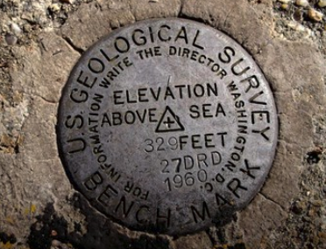
USGS and DataCite: Using DOIs to Assess Science Impact Viv Hutchison US Geological Survey June, 2019

Slide 2
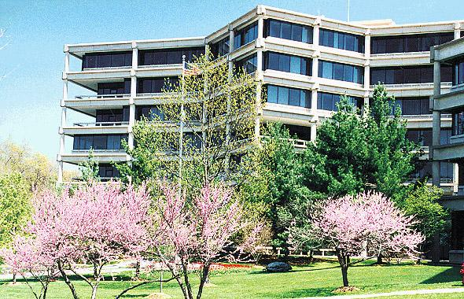
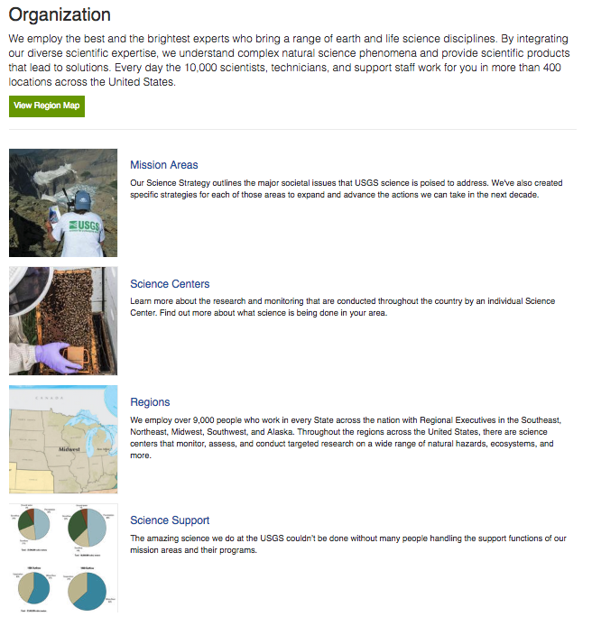
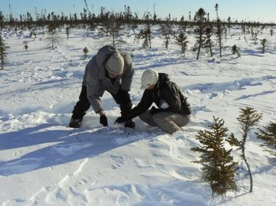
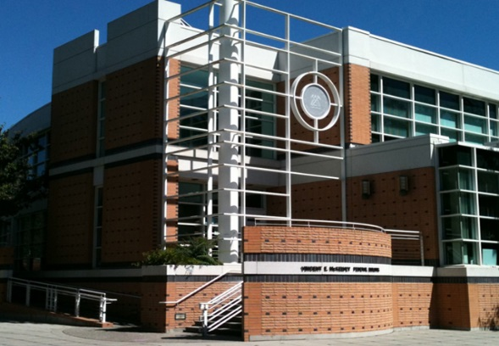
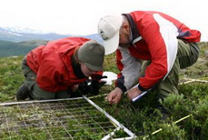
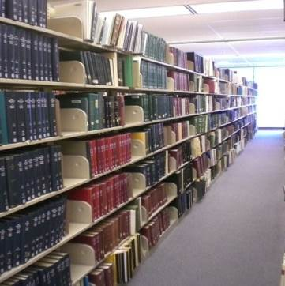
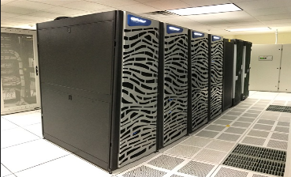
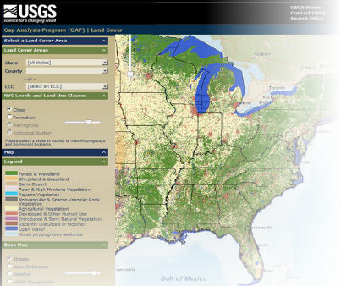
US Geological Survey: Organization
7 Mission Areas
Core Science Systems
Ecosystems
Energy and Minerals
Environmental Health
Land Resources
Natural Hazards
Water
7 Regions
Over 90 Science Centers + Research Stations (totaling over 400 facilities)
Science Support Offices
Notes:
Remote sensing, volcanos, earthquakes, etc

Slide 3
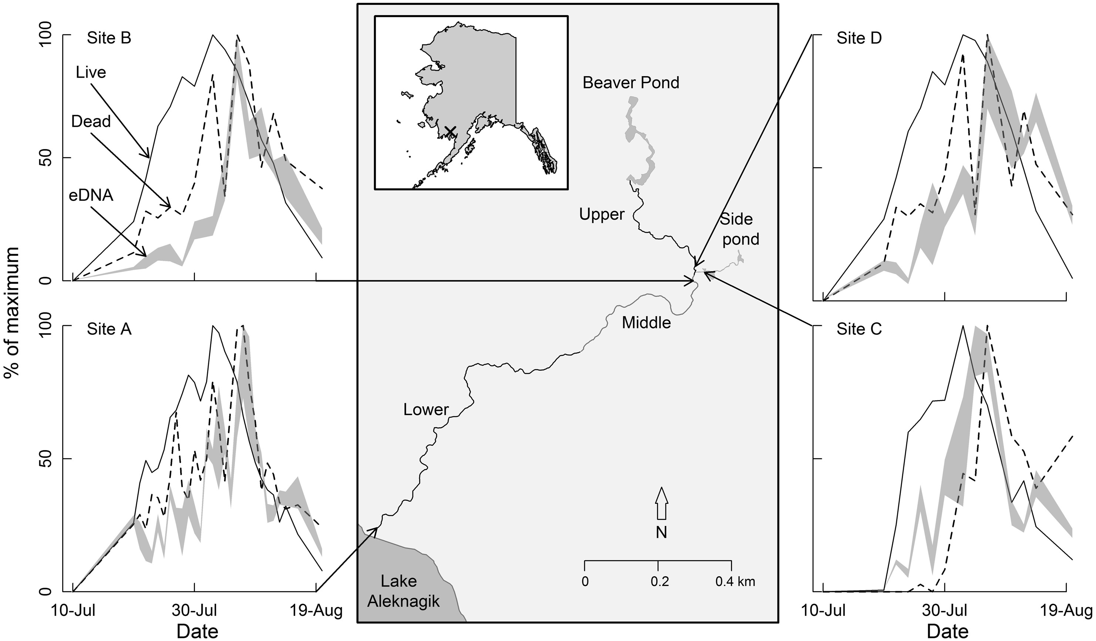
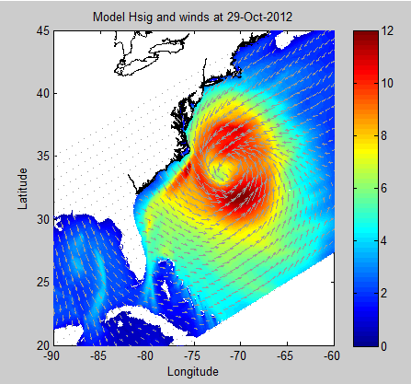
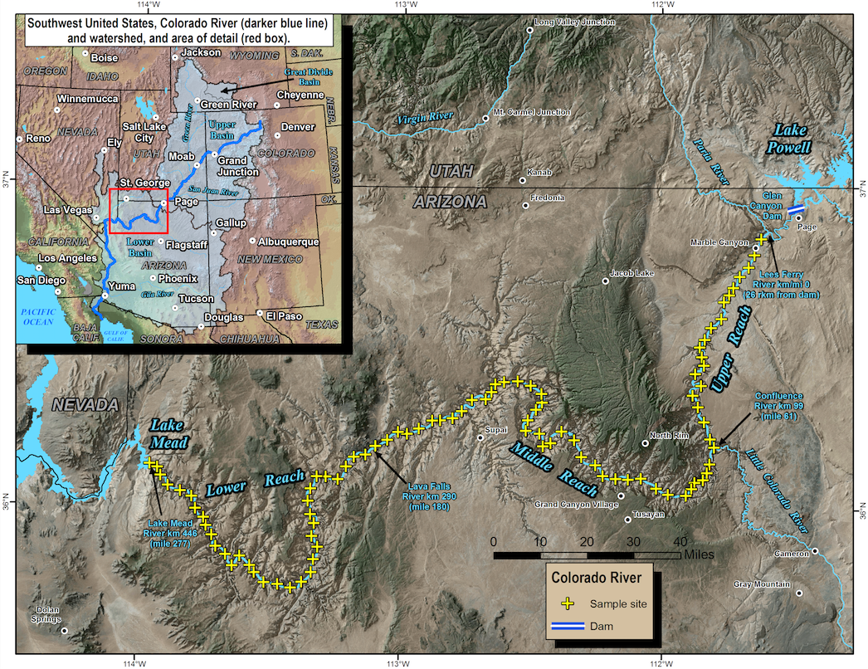
USGS Science Data:
varied types, sizes, formats
Multiple disciplines of Earth and biological sciences
Distributed environment in many Science Centers
Labs, field collection, instrument collection, mapping, remote sensing, and more
Many data formats
Wide variety of data sizes
Data integration needs
Hansen Creek, Alaska showing locations of eDNA sampling sites and visual count survey reaches
Modeling wave heights due to surface winds in Hurricane Sandy
Large River monitoring & mapping

Slide 4
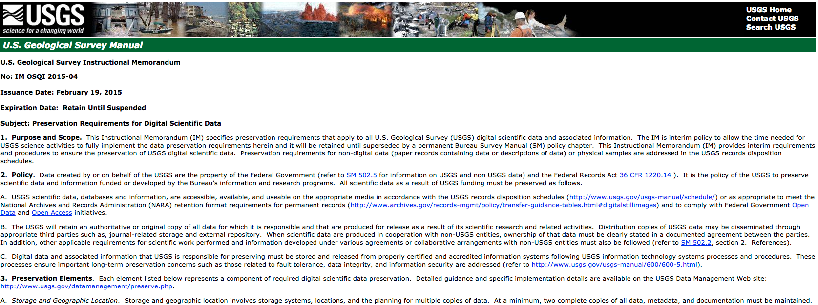
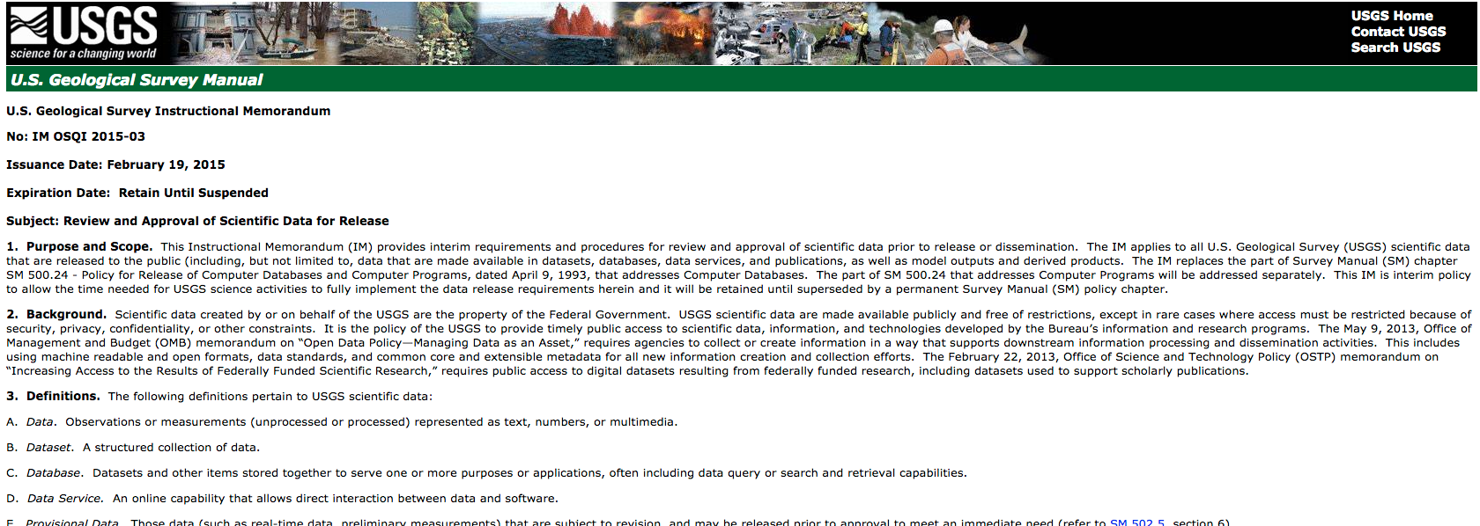
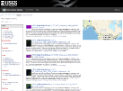
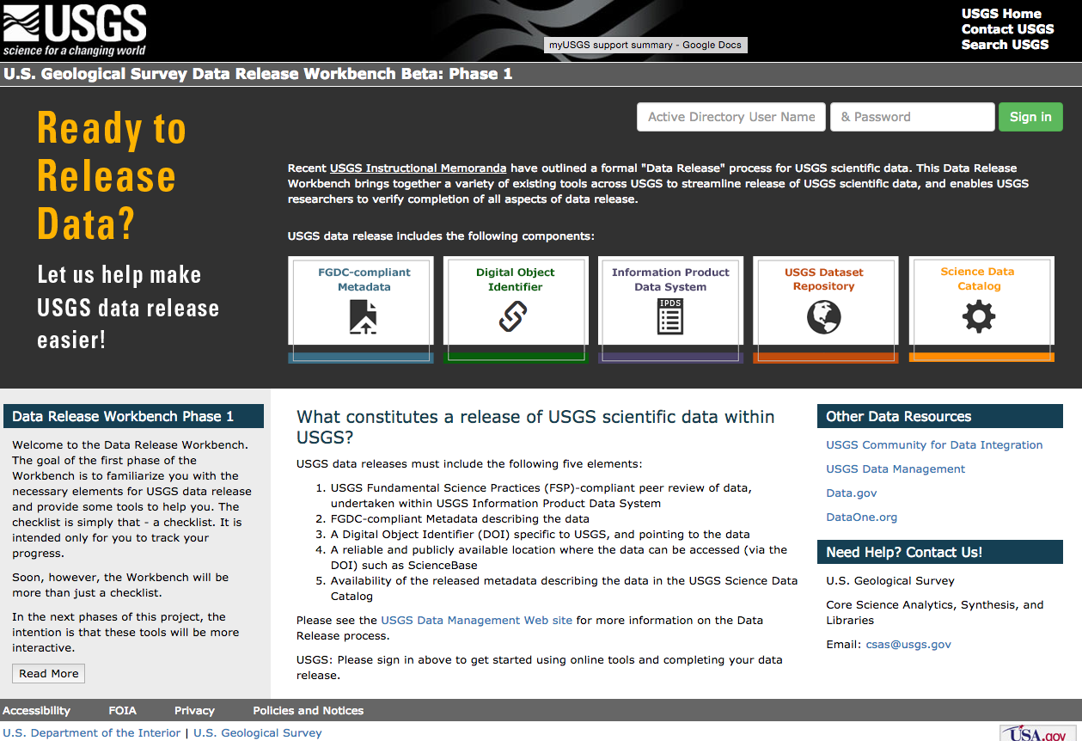
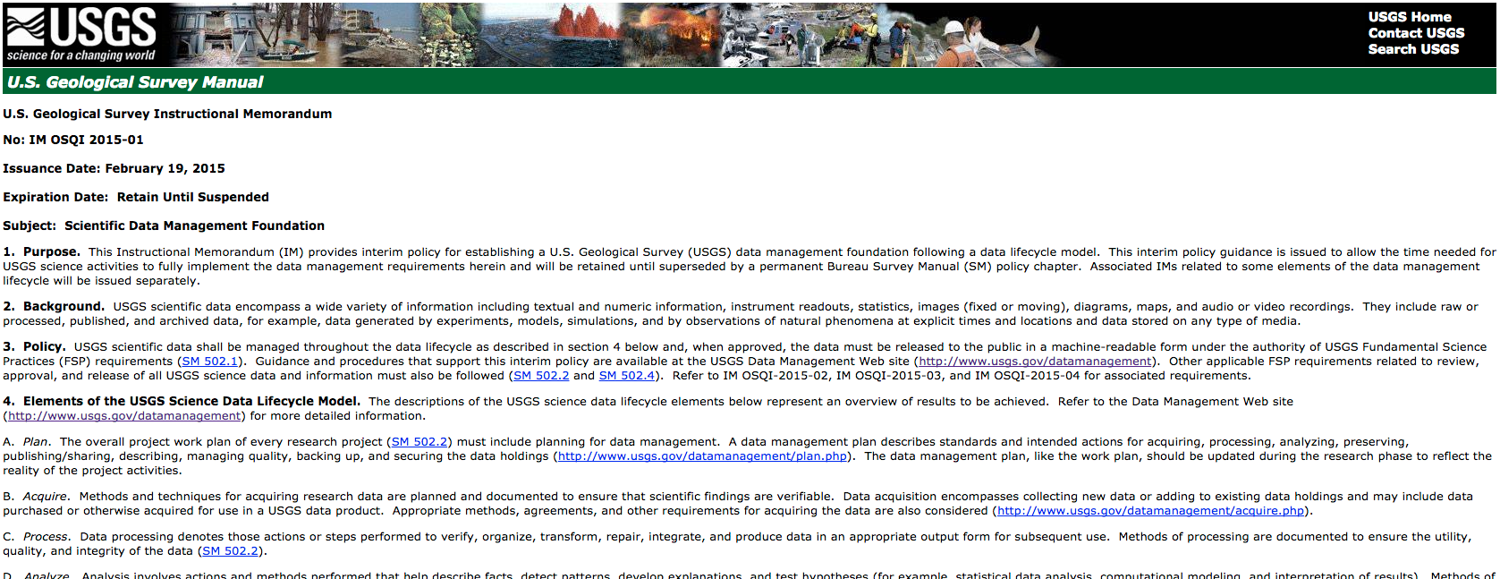
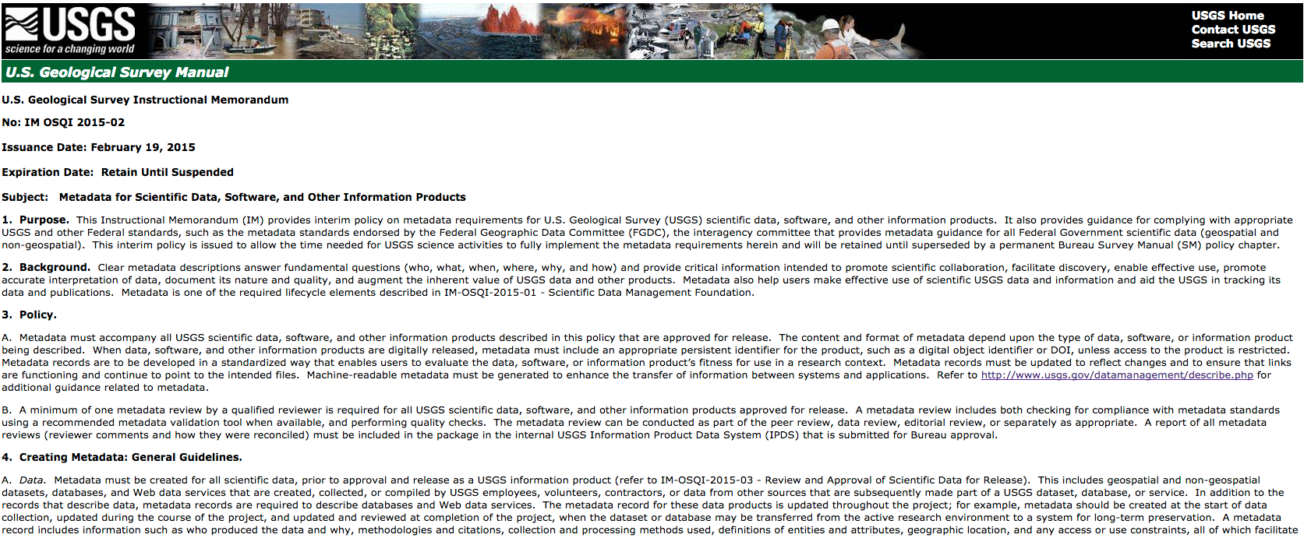
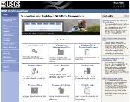
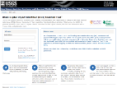
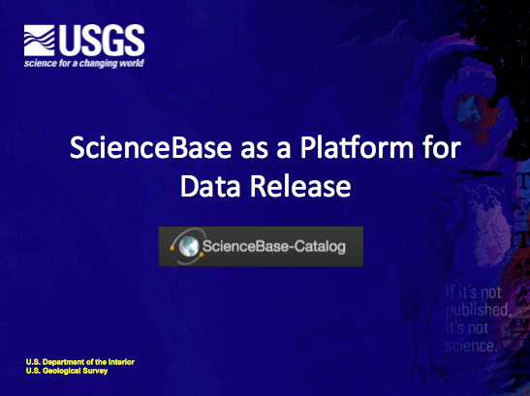
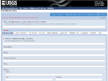
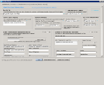

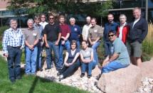
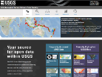

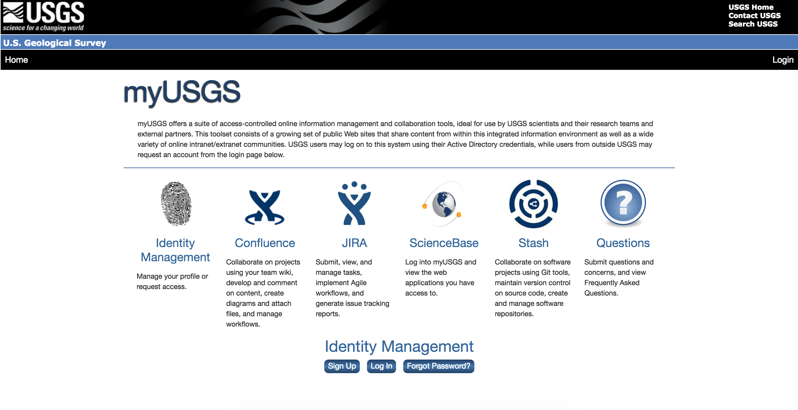

SAS Science Data Management Branch providing tools, best practices, and education for data management
Science Data Tools
Policies
Education
ScienceBase
sciencebase.gov
Data Release Workbench
https://data.usgs.gov/
datarelease/
DOI Creation Tool
www1.usgs.gov/csas/doi
USGS Data Management Website
usgs.gov/datamanagement
Online Metadata Editor
www1.usgs.gov/csas/ome
Metadata Wizard
sciencebase.gov/metadatawizard
Partnerships
USGS Powell Center
Science Data Catalog
data.usgs.gov
Community for Data Integration
usgs.gov/cdi
myUSGS
my.usgs.gov/resources
Notes:
How are we doing this?
This slide shows many, but not all, of the activities and tools that SAS supports for the Bureau.
We also provide tools, workflows, best practices, and expertise to USGS scientists to ensure their data is accessible, documented, repeatable, and reusable.
SAS led the development and publication of 4 new policies for USGS around data management. These policies support the broader goals of OSTP and OMB open data in Federal government initiated by the current administration, and support the fundamental reasons for performing data management in science, which include support for data integrity, accessibility, understanding and, ultimately, reuse.
A huge portion of this work (Science Data Lifecycle Model, Data Management Website, policies) is accomplished by leveraging the USGS community as well as outside partnerships. We facilitate and lead the Community for Data Integration to accomplish our goals – this community has over 900 members.
- CDI won the 2015 Excellence in Government Award from the American Council for Technology and Industry Advisory Council (ACT-IAC).

Slide 5
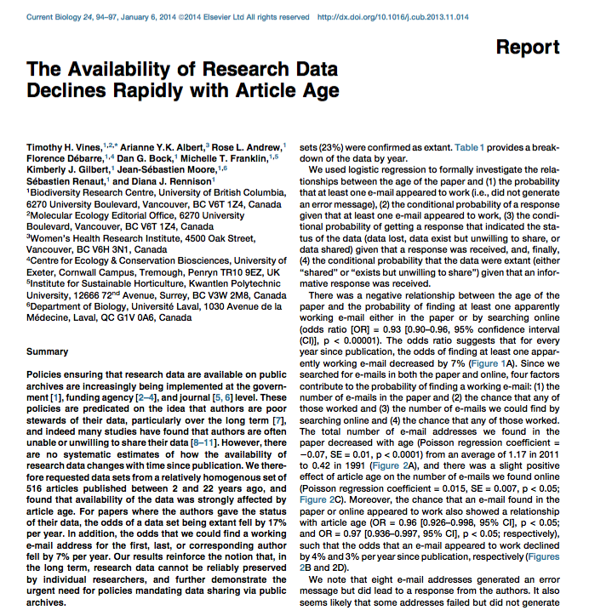
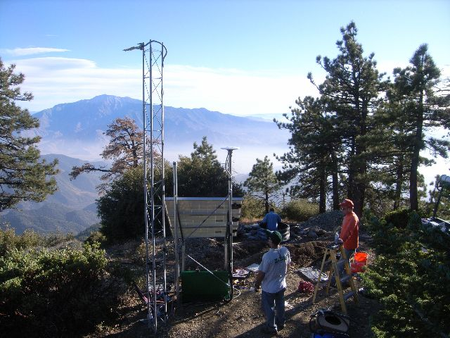
The case for DataCite DOIs for science data
USGS Goals with DataCite DOIs:
Track science impact through DOIs and citation
Citation & Author Credit: Ensure authors receive credit and can track for tenure and promotion
Ensure links persist for USGS data;
Unambiguously identify and distinguish datasets
Use DOIs to link data to publications
“The odds of finding the original data for …papers fell by 17 percent every year after publication.”
“The data are thus unavailable for future researchers to check old results or use for entirely new purposes.”
Notes:
Studies such as this one have shown that there is a rapid decline in our ability to access original data as time progresses. The further we get from the time of publication, the harder it is to access the data.
Article Source:
http://www.sciencedirect.com/science/article/pii/S0960982213014000
Photo Source:
EROS Data Center, USGS Archivist

Slide 6
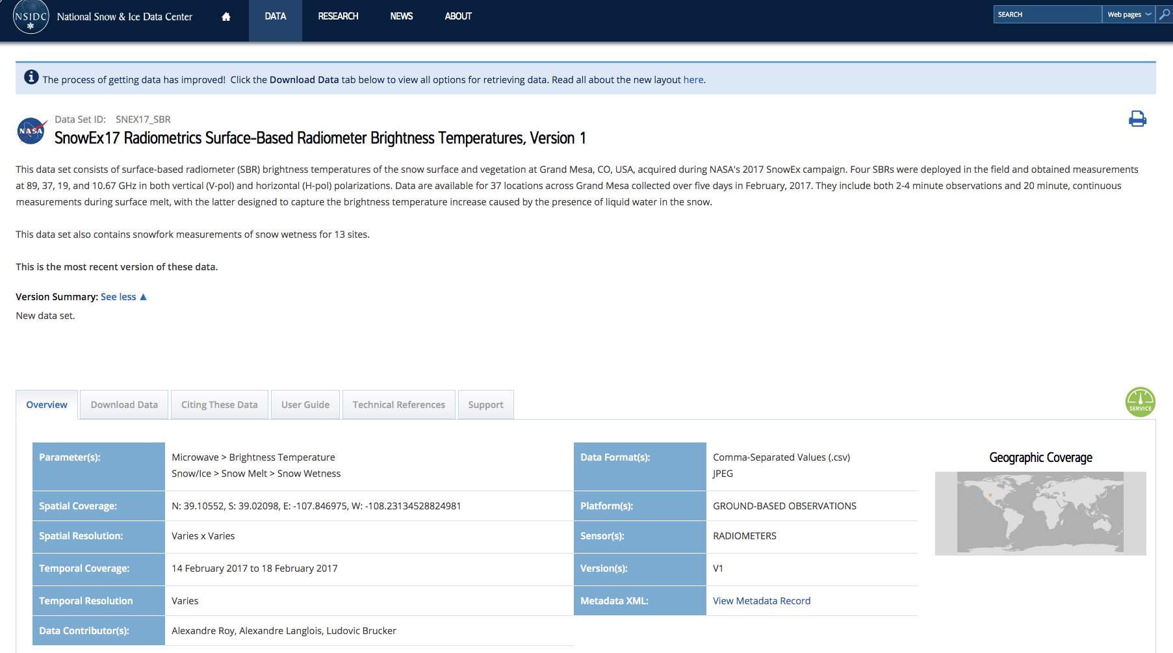
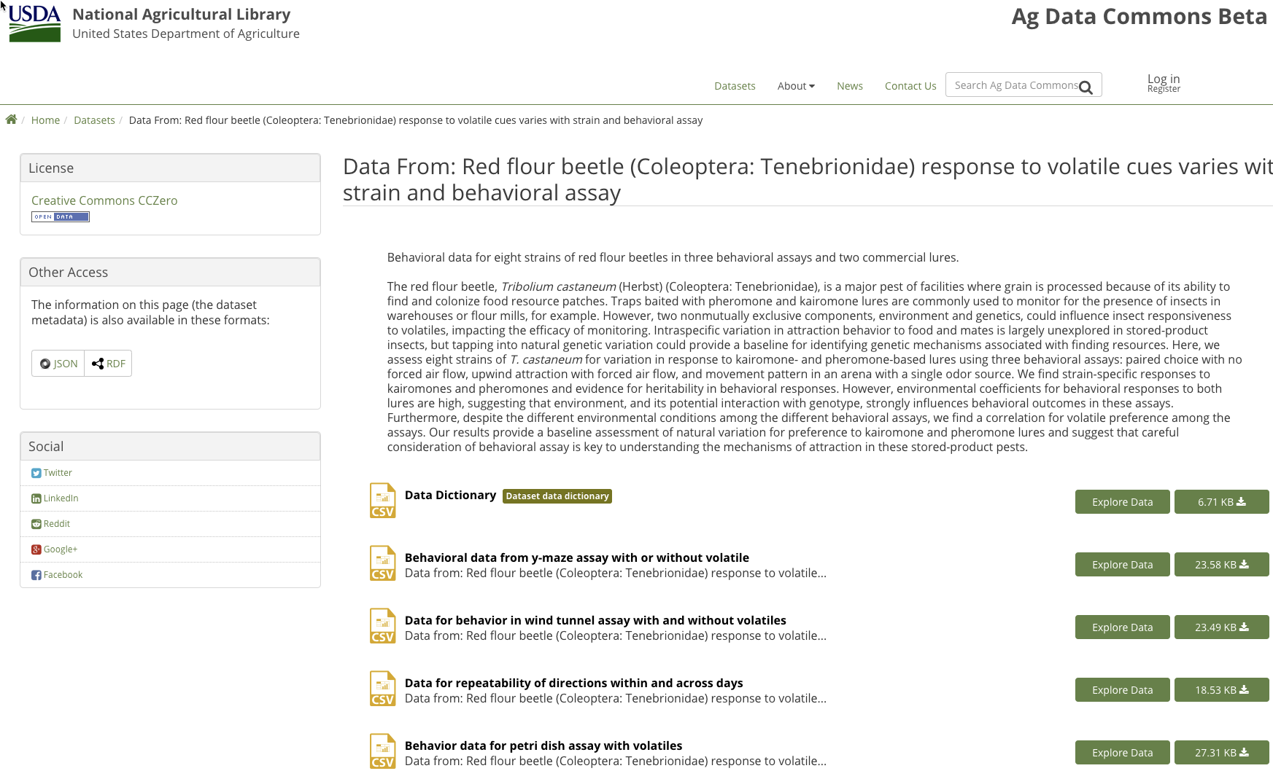
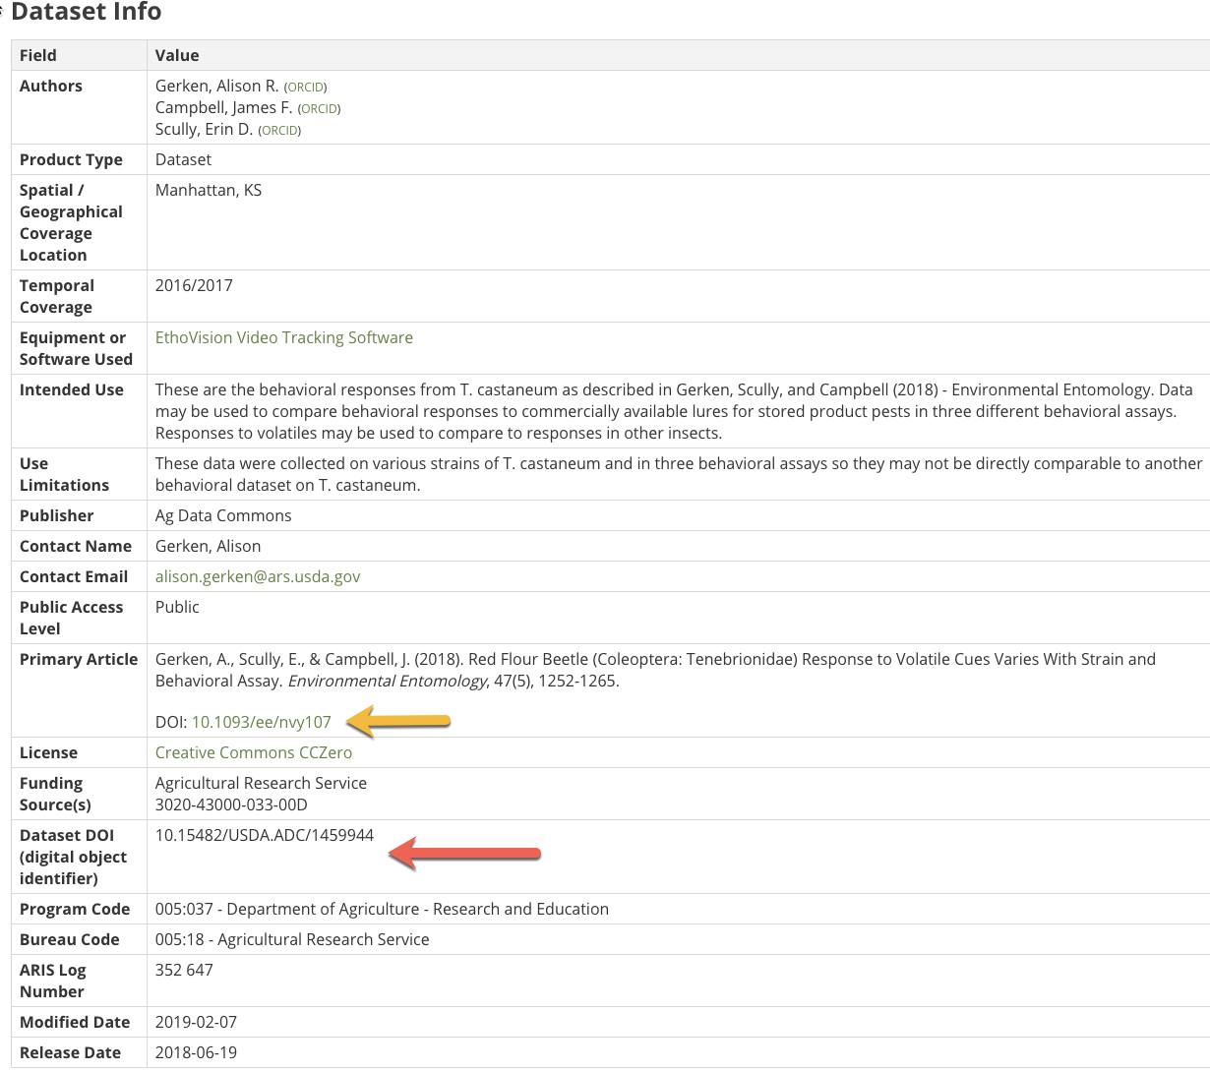
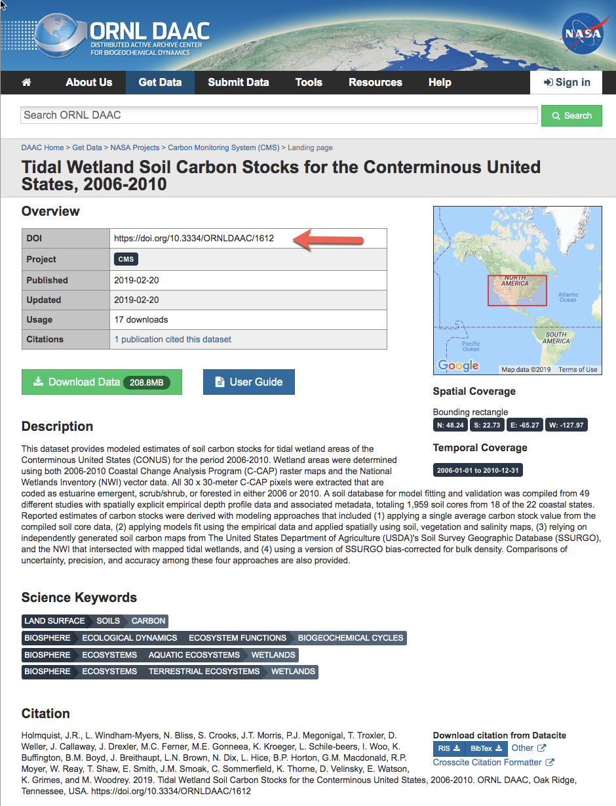
Federal Government Use of DataCite DOIs
National Snow and Ice Data Center
US Department of Agriculture
Department of Energy - ORNL DAAC

Slide 7
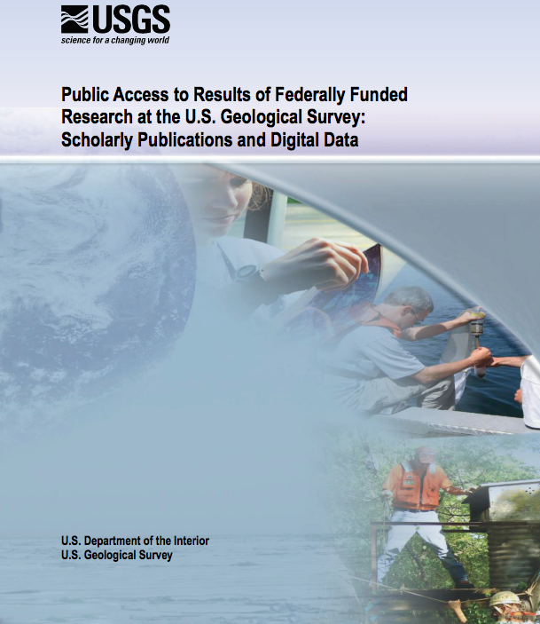
USGS Publishes Public Access Plan
M-13-13 Open Data Policy
USGS Response, published in 2016:
“Public Access to Results of Federally Funded Research at the U.S. Geological Survey: Scholarly Publications and Digital Data”

Slide 8
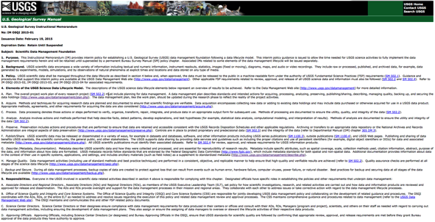
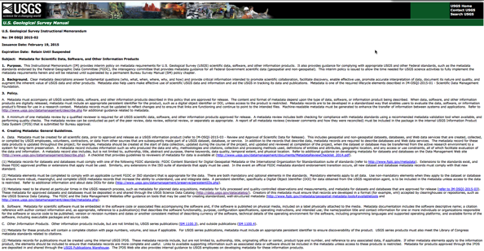
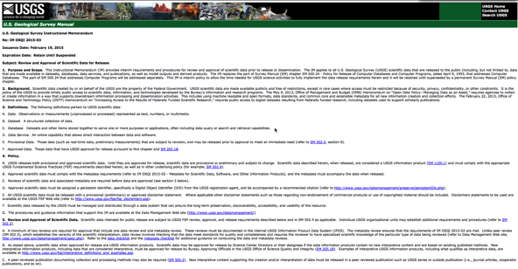
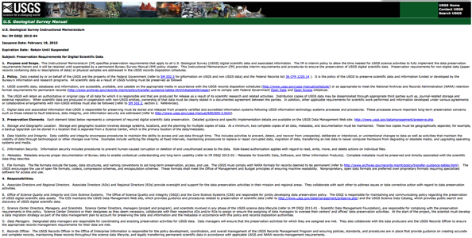
FSP Data Management Policies
4 new policies for data management & public access
FSP - Data Management Policies
Scientific Data Management Foundation (requires DMPs)
Metadata for Scientific Data, Software, and Other Information Products
Review and Approval of Scientific Data for Release
Preservation Requirements for Digital Scientific Data

Slide 9
USGS Data Management Policies
Data
The policies require, for scientific data:
A detailed data management plan for all research projects
Data in machine readable, open formats
Standard metadata describing the data
A digital object identifier for the data, recorded in the metadata record
Approvals: requiring data review, metadata review, and either Center Director or Bureau Approving Officials
Hosted and shared from a reliable, repository location
Metadata shared through the USGS Science Data Catalog
Review & Approval
Publish

Slide 10
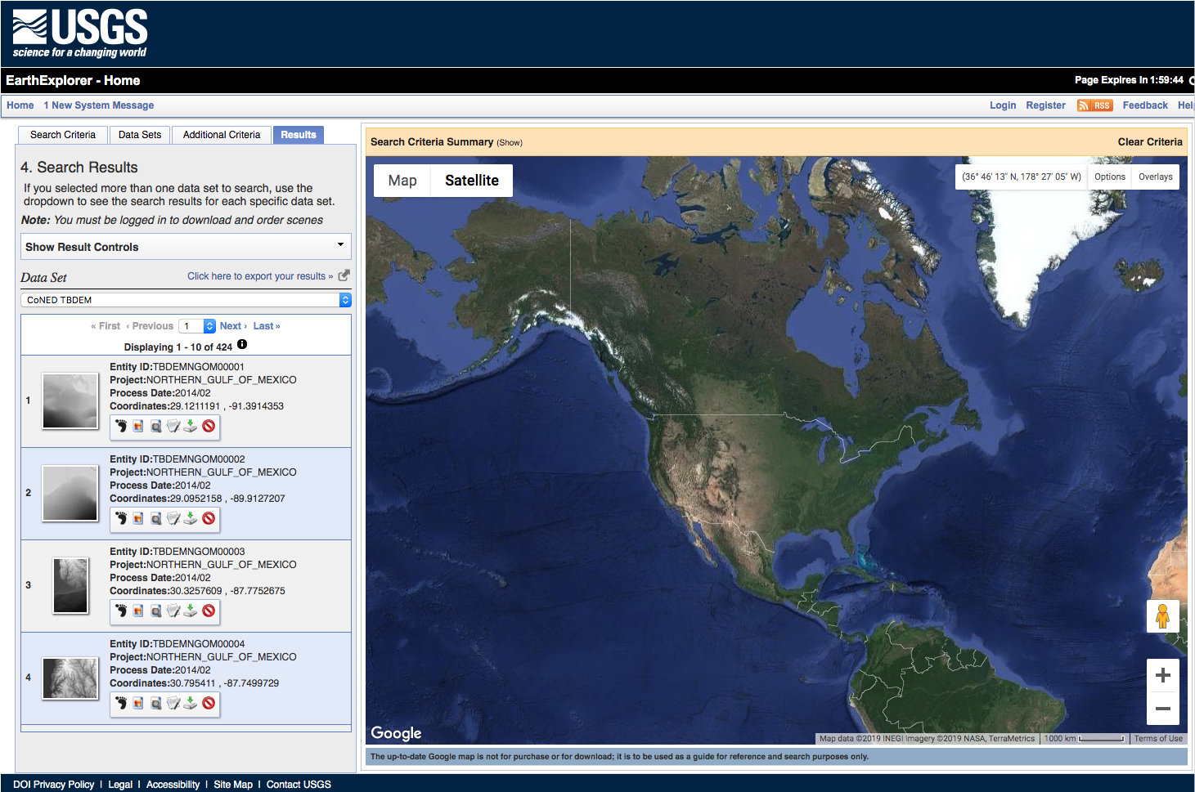
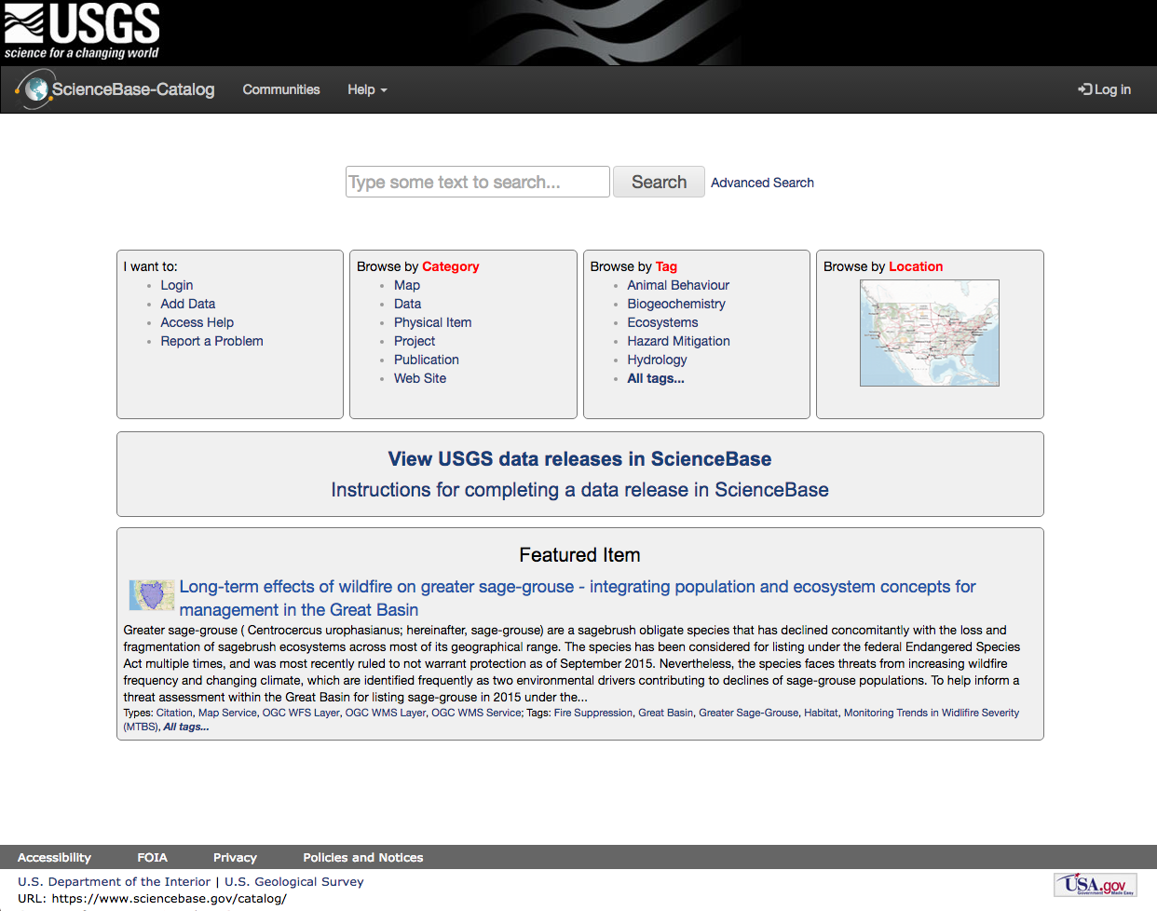
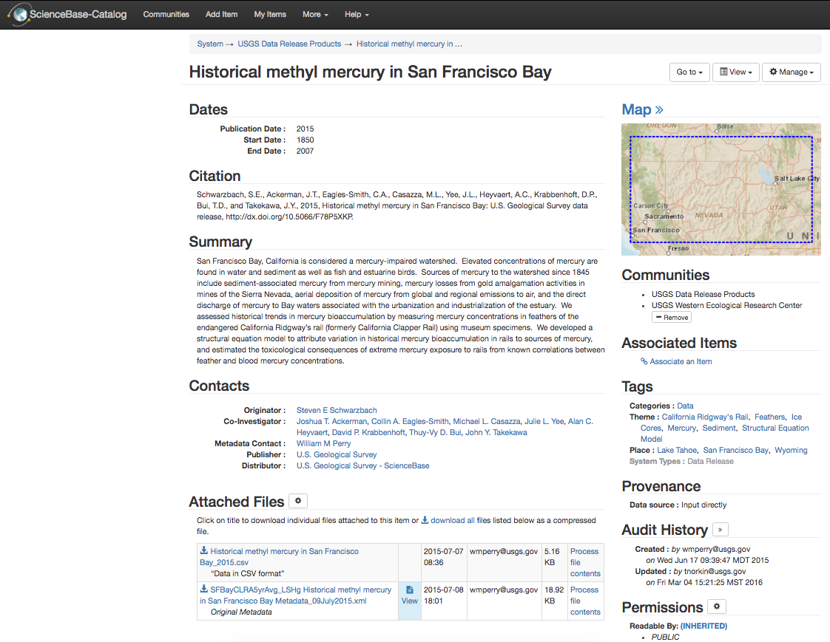
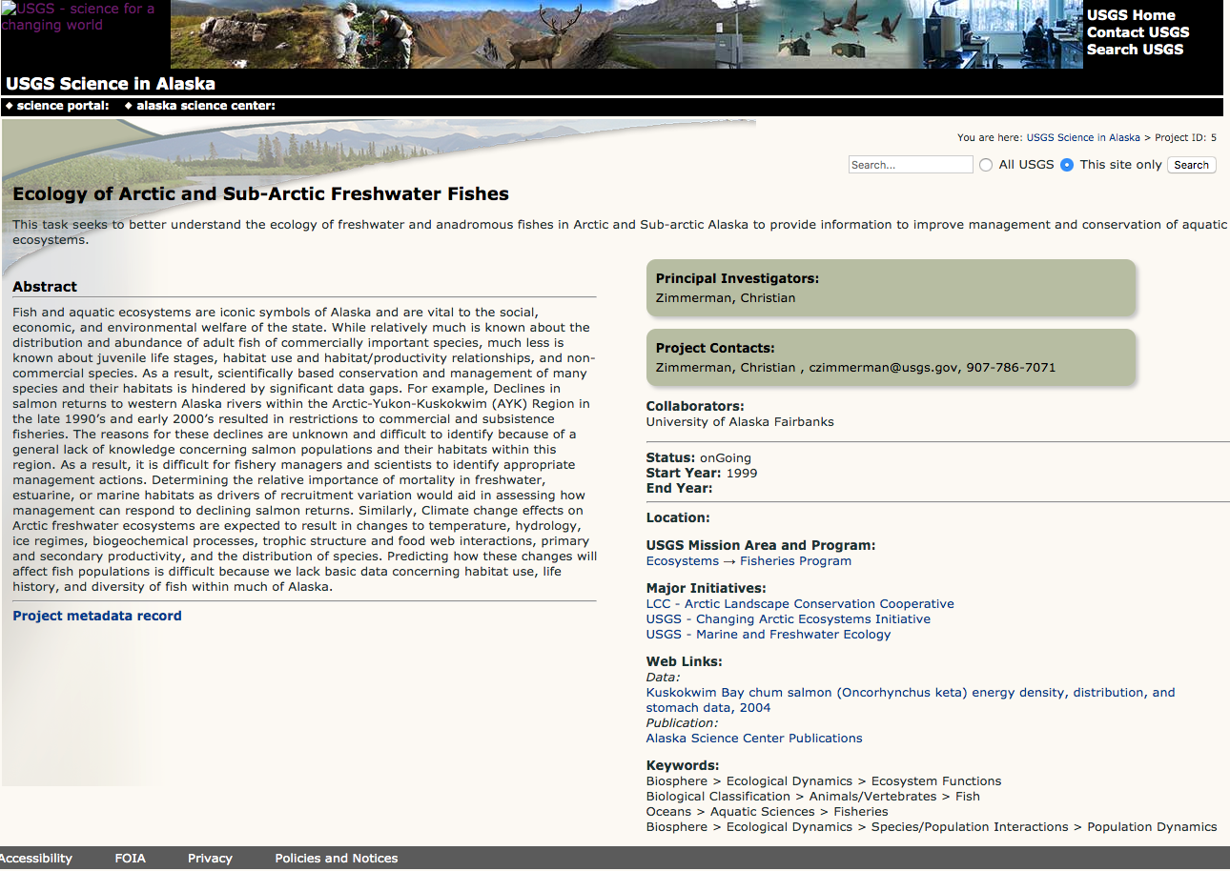
Many Repositories, all USGS data
USGS has multiple science data stores, repositories
DOIs help to connect the resources together

Slide 11
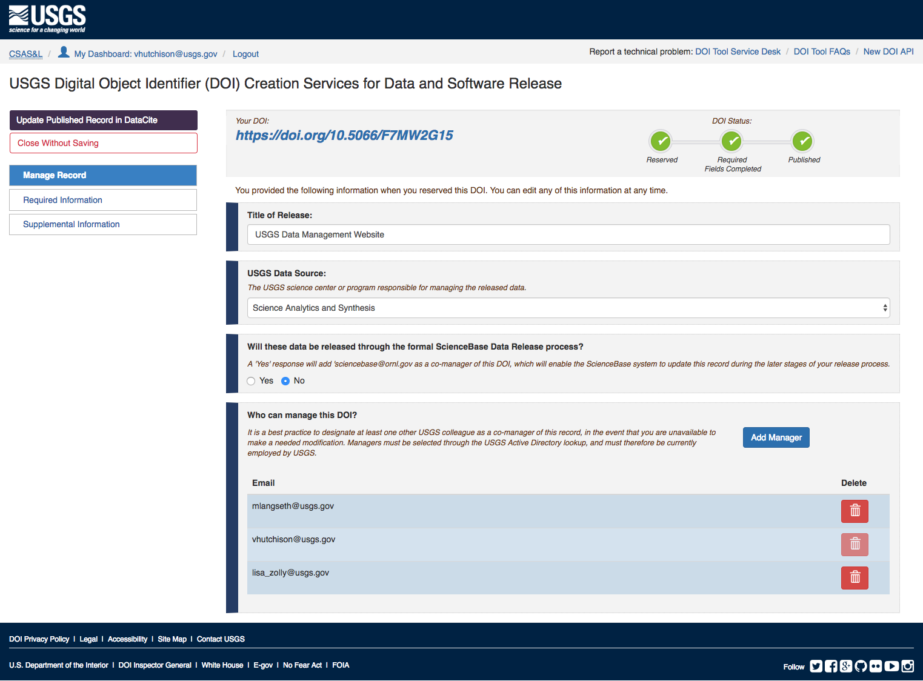
USGS Digital Object Identifier (DOI) Tool
Allows creation of an DataCite doi for USGS datasets only
DOIs are used in citation and are included in metadata records
DOIs can be reserved and published

Slide 12
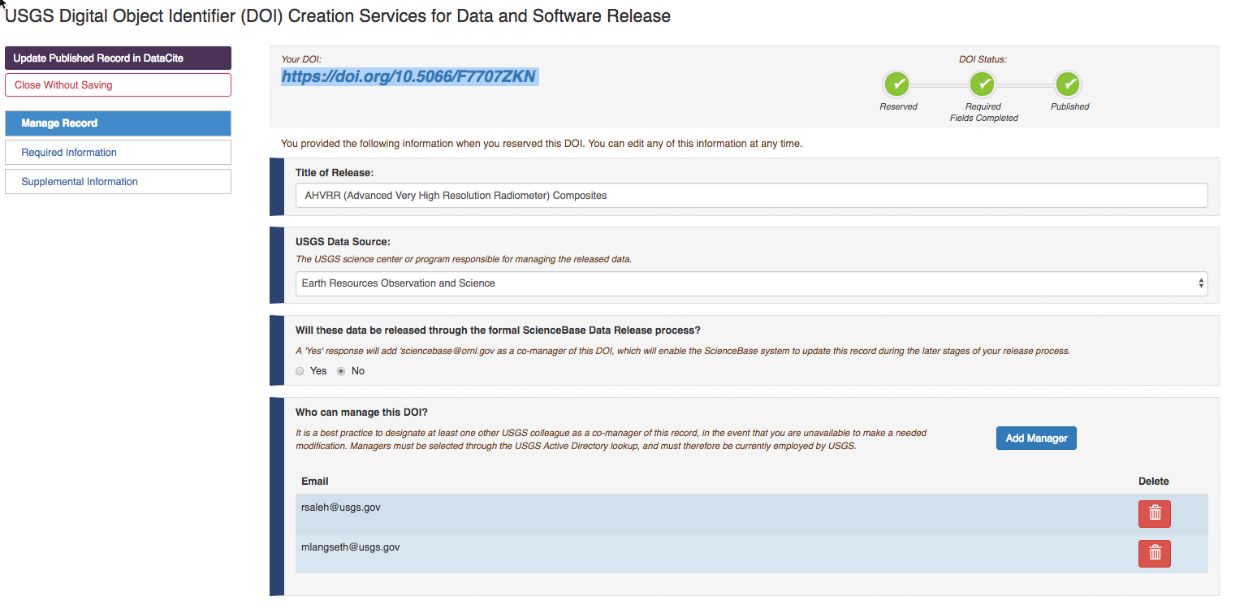

See status at a glance

Slide 13
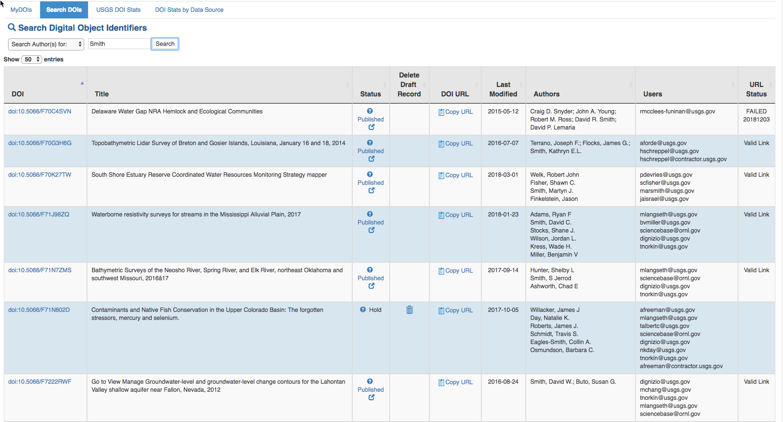
Dashboard
This unpublished DOI can be deleted if no longer needed
Status of Location URL link check
Copy and paste your DOI URL quickly without needing to open the full record

Slide 14
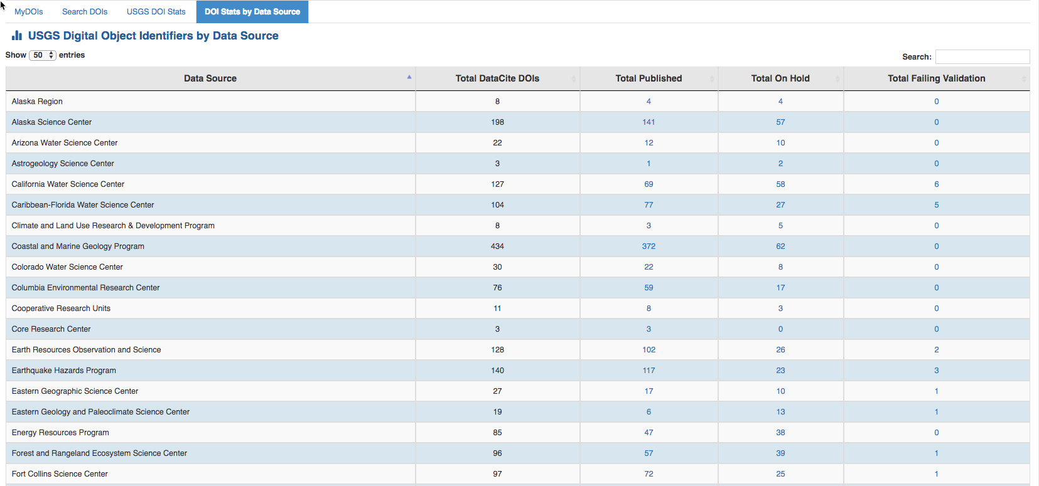
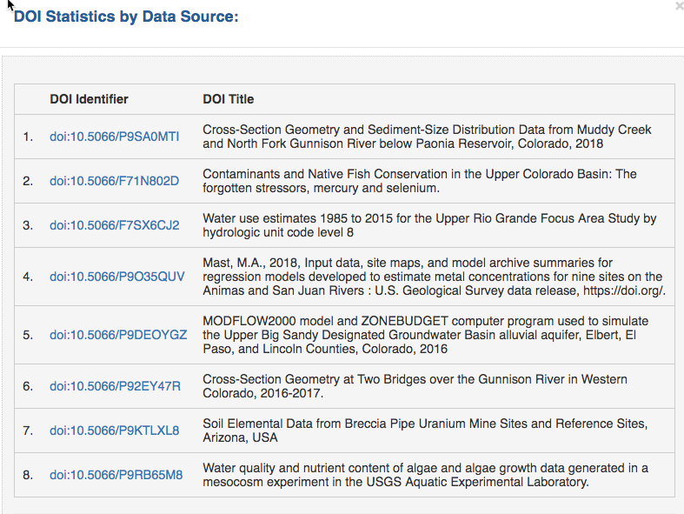
Metrics

Slide 15
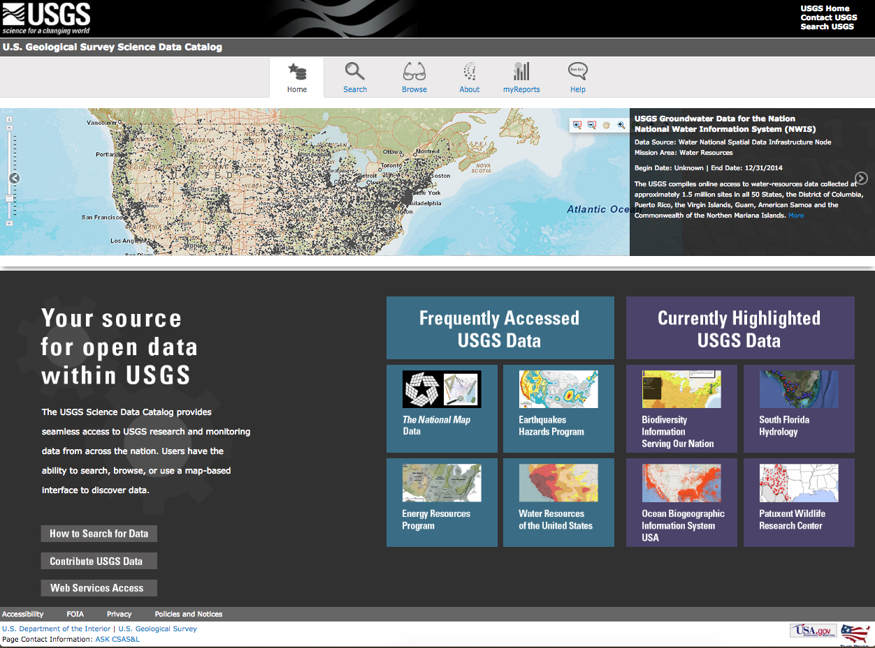
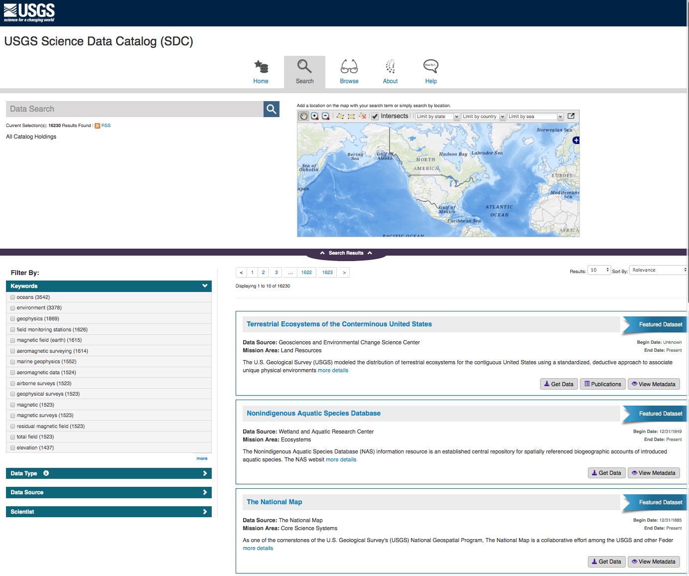
USGS Science Data Catalog
1 of 3 applications
Catalog of all metadata records describing data released by USGS
Reporting capability to OMB
Serves metadata to Department of Interior
data.usgs.gov

Slide 16
USGS ScienceBase Trusted Digital Repository Note the data, metadata, citation, DataCite digital object identifier…
USGS ScienceBase: Trusted Digital Repository
2 of 3 applications
Data Citation
Data
Metadata

Slide 17
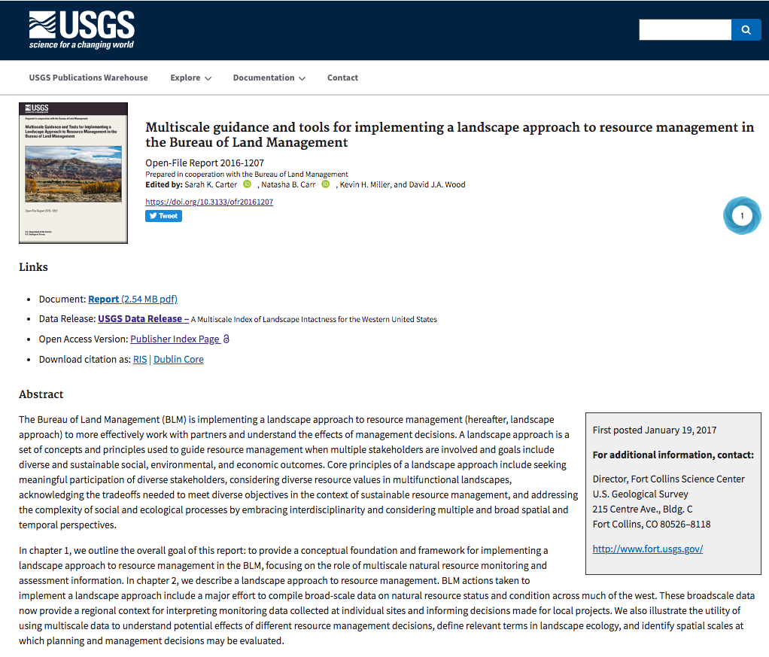
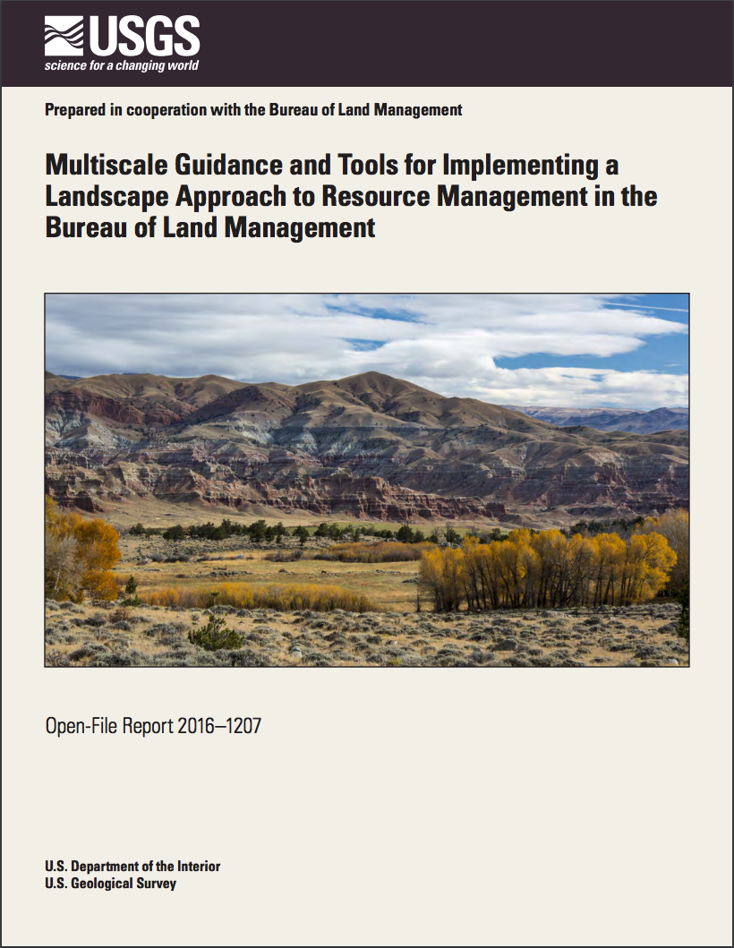

USGS Publications Warehouse 3 of 3 applications

Slide 18




Linking data to publications: 3 systems

Slide 19


Slide 20



Next Steps
Gathering and reporting citation metrics from DOIs to better inform scientists of research impacts
Establish USGS as a DataCite consortium member for bureaus in Department of the Interior
Increase data citation rates in USGS authored publications
Continue to implement FAIR: ensure data is findable, accessible, interoperable, and reusable for future research

Slide 21


Thank you!
Questions? Comments?

